Slide 1

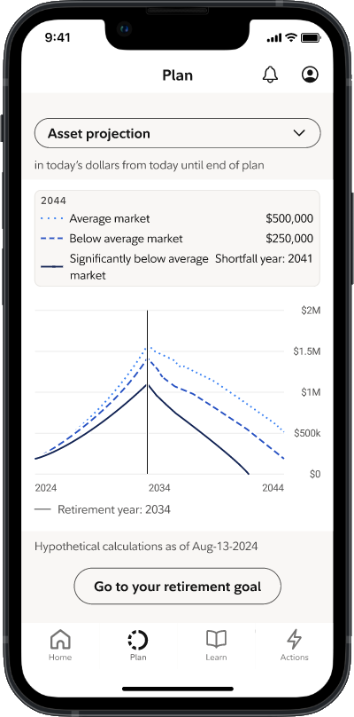
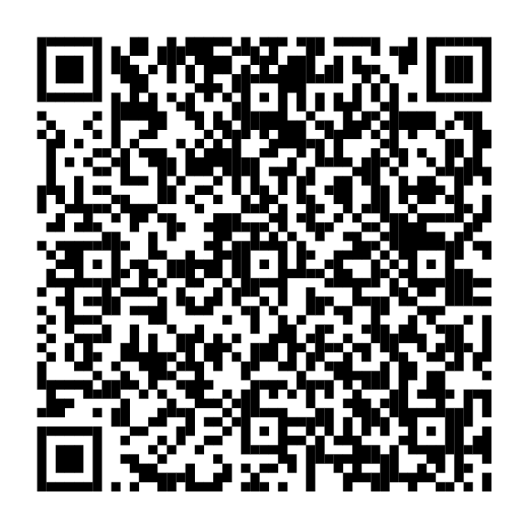
Financial Wellness Month
Get help with your money goals this year.
Your financial wellness dashboard on NetBenefits® has tips to help you make progress toward your money goals this year—all with personalized insights to fit your life.
To view your dashboard, scan the code or visit NetBenefits.com/dashboard.
Screenshot is for illustrative purposes only.
NetBenefits and the Fidelity Investments logo are registered service marks of FMR LLC. Fidelity Brokerage Services LLC, Member NYSE, SIPC, 900 Salem Street, Smithfield, RI 02917
© 2025 FMR LLC. All rights reserved. 1226081.1.1

